Slide 1
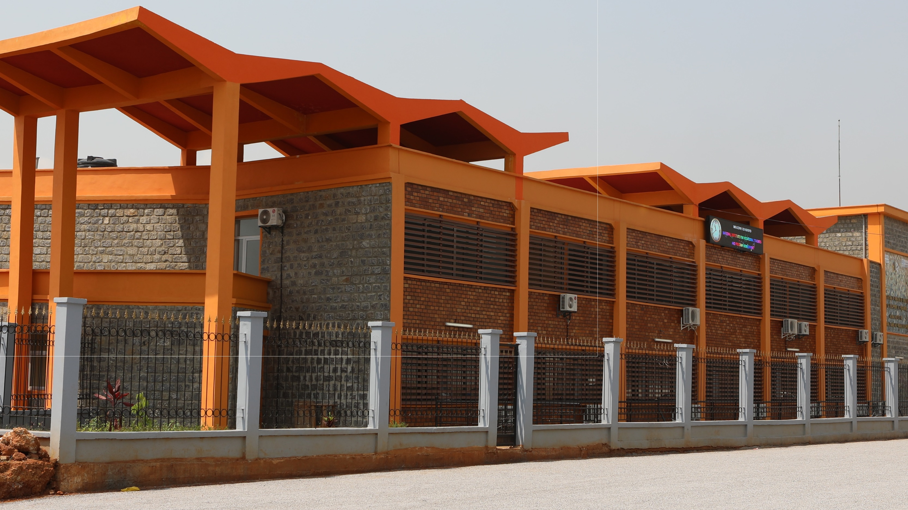

NTTPDC
National Trainer Training and Programmes Development Centre
© NTTPDC. All Rights Reserved.

Slide 2

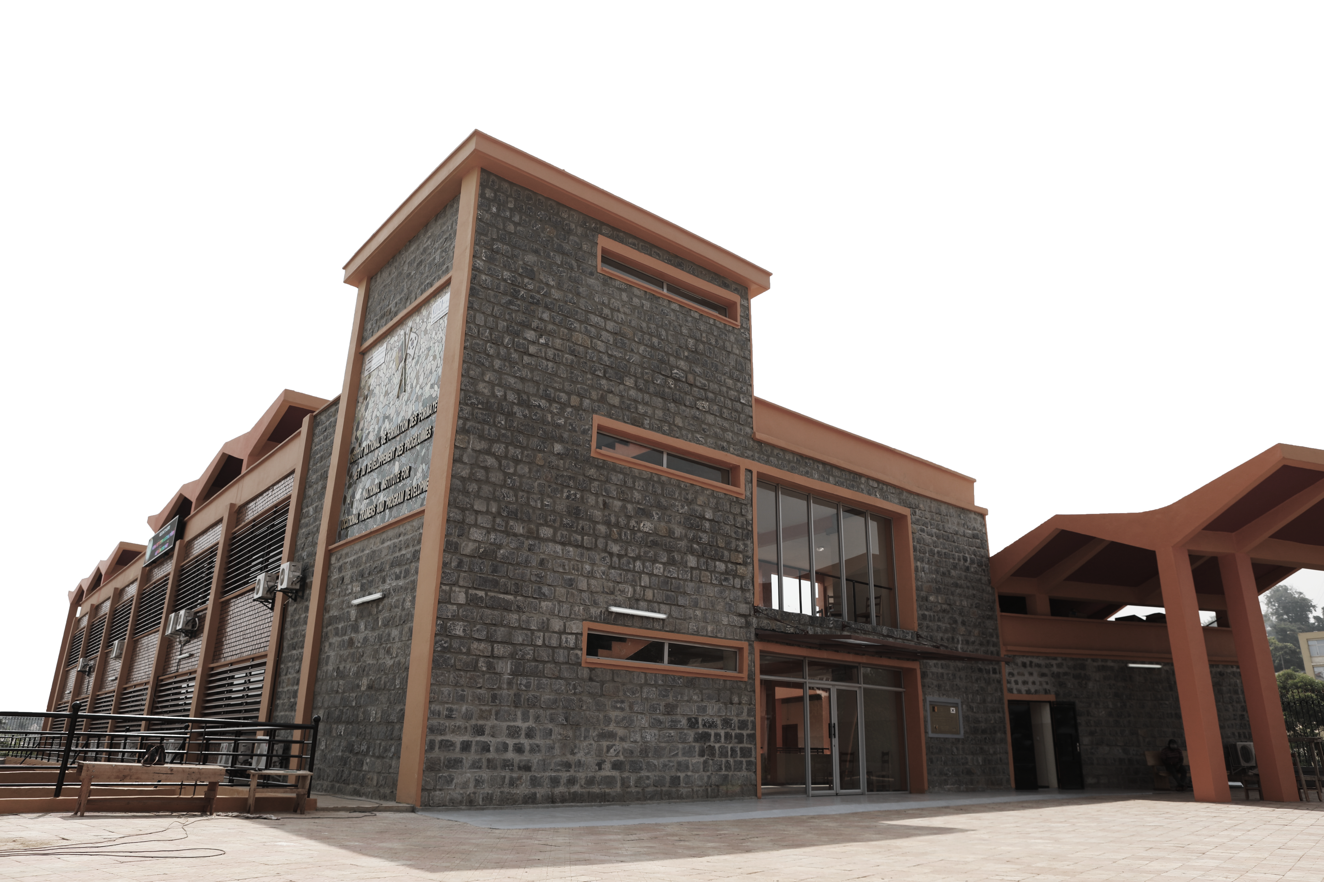
NTTPDC
Product of the international Cooperation between Cameroon and Korea through KOICA
Created on 04th May 2023 by
The Presidential Decree No 2023/237
Notes:
KOICA : Agence Coréenne de Coopération Internationale

Slide 3

Role
Help develop Cameroon industry and economy by providing trainers whose technological and pedagogical skills are adapted to the needs of the industry.

Slide 4

2
1
Production of training and pedagogical support tools
3
Continuous, pedagogical and adult education training of trainers and public and private institutions personnel
Drawing up, implementing, approving, revising reference systems, programmes and training and apprenticeship manuals
MISSIONS
4
Research engineering support for decentralised local authorities and businesses
5
Research and support for engineering development
6
Integrating digital technologies into the preparation, delivery and assessment of training courses
7
Using social network application basic functions

Slide 5
1
2
3
Drawing up, implementing, approving, revising reference systems, programmes and training and apprenticeship manuals
Production of training and pedagogical support tools
4
MISSIONS
Research engineering support for decentralised local authorities and businesses
5
Research and support for engineering development
6
Integrating digital technologies into the preparation, delivery and assessment of training courses
7
Using social network application basic functions

Slide 6
1
2
3
Drawing up, implementing, approving, revising reference systems, programmes and training and apprenticeship manuals
MISSIONS
4
Research engineering support for decentralised local authorities and businesses
5
Research and support for engineering development
6
Integrating digital technologies into the preparation, delivery and assessment of training courses
7
Using social network application basic functions

Slide 7
1
2
4
3
Support research engineering for decentralised local authorities and companies
MISSIONS
5
Research and support for engineering development
6
Integrating digital technologies into the preparation, delivery and assessment of training courses
7
Using social network application basic functions

Slide 8
1
2
5
3
Research and support for engineering development
MISSIONS
4
6
Integrating digital technologies into the preparation, delivery and assessment of training courses
7
Using social network application basic functions

Slide 9
1
2
6
3
Integrating digital technologies into the preparation, delivery and assessment of training courses
MISSIONS
4
5
7
Using social network application basic functions

Slide 10
1
2
7
3
4
Using social media application basic functions
MISSIONS
5
6

Slide 11
1
Trainer training
The NTTPDC offers certified trainings for trainers.
Training offers
2
A la carte trainings
The NTTPDC offers personalised trainings according to the participants’ specific needs.
3
IT Training
The NTTPDC offers Information and technology (IT) AND multimedia trainings.

Slide 12
Training Curricula Development
The NTTPDC develops, adapts and boost the evolution of the methodological framework for drawing up the vocational training programmes according to the Competency-Based Approach (CBA).
1
2
Drawing up Training Reference Frameworks
The NTTPDC draws up and updates training reference frameworks with all its components.
Programme Development
Implementation Support
3
The NTTPDC supports the implementation of vocational training and apprenticeship programmes.

Slide 13





Cafeteria
Library
Printing Unit
Services
Meeting Rooms

Slide 14

Trainers of public and private vocational training institutions
1
2
Companies, public, mixed-economy and private administrations
Our Targets
3
Decentralised Local Authorities
4
Professional and Employers’ Organisations and Universities
5
Professional looking for a career change

Slide 15

Level 3
CNFPM: National Vocational Trainer Certificate- Master.
Types of certifications
Level 2
CNFPS: National Vocational Trainer Certificate- Senior
Level 1
CNFP: National Vocational Trainer Certificate-

Slide 16

NTTPDC
National Trainer Training and Programme Development Centre
© NTTPDC. All Rights Reserved.

